Slide 1


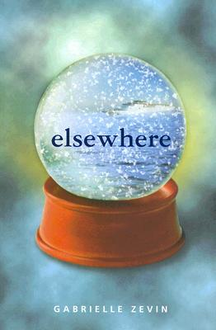
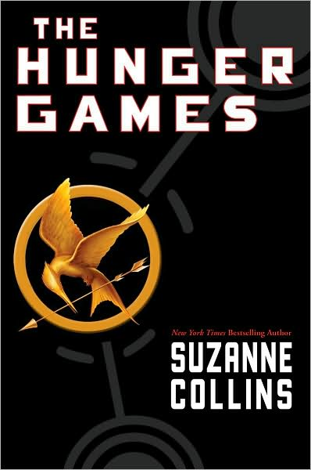


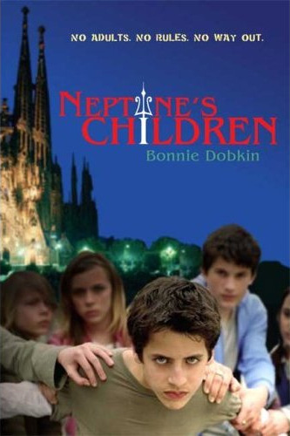

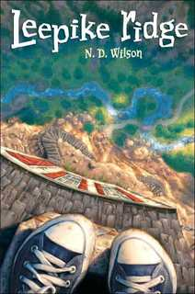
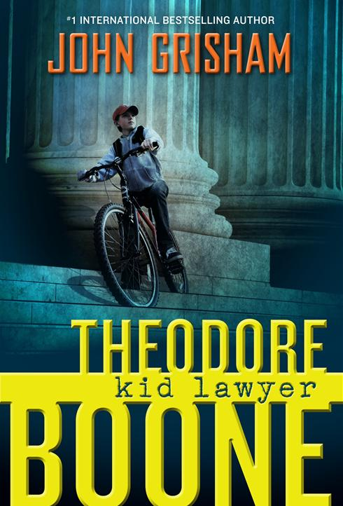
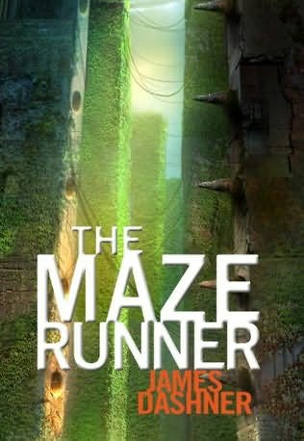
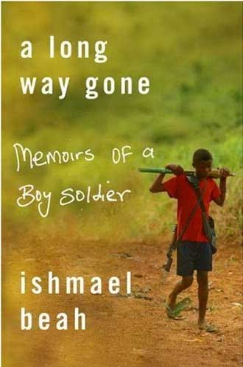
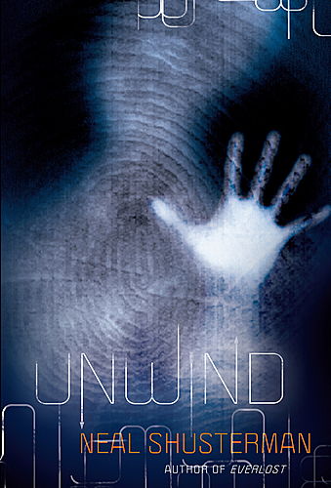
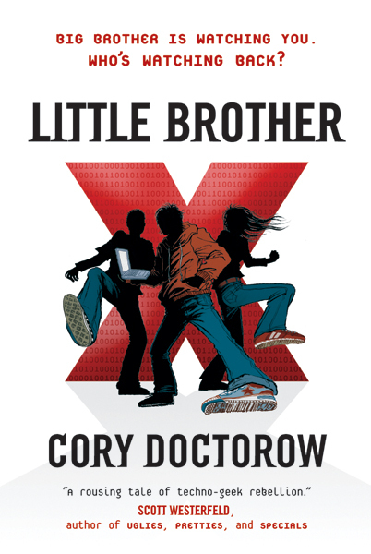
2010
Christy Keeler’s
Bookshelf
Currently Reading…

Slide 2


Elsewhere
Elsewhere
Elsewhere is the story of a girl who died. Upon doing so, she arrived at a place called “Elsewhere” where all the people had lived lives on Earth and were now dead. Most of the people were a lot older than her (she died in her teens). A unique feature of Elsewhere is that you grow older instead of younger while there.
Return to Bookshelf

Slide 3
Hunger Games
The Hunger Games
The Hunger Games is the first of a trilogy by Suzanne Collins. The premise underlying the plot is that a corrupt “Capitol” controls 12 districts. To keep the districts under control, the Capitol sponsors The Hunger Games each year. Two children from each district are selected to participate, and only one participant from the 24 survives the Games.
Return to Bookshelf

Slide 4
Uglies
Uglies
This series (including Pretties, Specials, and Extras) by Scott Westerfield begins with Uglies, a book about a utopian society that spawned from modern America. All children are called “uglies” until their 16th birthdays on which they receive an operation that makes them pretty. Once pretty, they move to a location where they can play and party all the time. Some uglies, though, question if being pretty is all there is to life.
Return to Bookshelf

Slide 5
Fallen Angels
Fallen Angels
Fallen Angels is realistic historical fiction about serving in the Vietnam War. The main character is African-American, adding to the issues of race conflict occurring during the war.
Warning: Telling the story of men and women serving on the front lines, the book does not “candy-coat” the violence, language, and other everyday happenings of the U.S. soldiers.
Return to Bookshelf

Slide 6
Neptune’s Children
Neptune’s Children
Dobkin’s book, Neptune’s Children, begins with a bioterrorist attack on all adults around the world. All individuals over age 13 die instantly, leaving all children behind to fend for themselves. Those children left behind in a theme park (similar to Disneyland), create a working society while facing potential and real threats.
Return to Bookshelf

Slide 7
Adoration of Jenna Fox
The Adoration of
Jenna Fox
Jenna Fox awakens after a coma having forgotten her life before her accident. She explores her past life through video, but is often met with reluctance to talk about her operation with others.
This mystery explores issues related to bioethics.
Return to Bookshelf

Slide 8
Leepike Ridge
Leepike Ridge
This action-filled story of realistic fiction is a fun read. When the main character finds himself in a hidden cave under Leepike Ridge, he learns about life outside the mainstream.
Return to Bookshelf

Slide 9
Theodore Boone
Theodore Boone:
Kid Lawyer
This is John Grisham’s first children’s book. Theodore Boone lives with his parents, both of whom are lawyers. He loves the law and spends all his free time in the courthouse. As such, he is the resident expert on the law at his school, and he regularly advises his classmates on legal matters. He eve becomes entwined in a case of his own!
This is a great book to learn about the U.S. legal system.
Return to Bookshelf

Slide 10
Theodore Boone
A Long Way Gone
A Long Way Gone: Memoirs of a Boy Soldier is the true story of Ishmael Beah, a boy who served as a soldier in Sierra Leone. After his hometown was attacked by rebels, he spent months searching for his family before being recruited into guerrilla warfare. He is later reformed when living in a UNICEF refugee camp.
Warning: This book contains graphic violence.
Return to Bookshelf

Slide 11
Unwind
Unwind
Imagine if parents could choose to have their teenagers “unwound,” have their body parts separated and given to save the lives of others. It’s the perfect solution for harvesting human organs… isn’t it?
Return to Bookshelf

Slide 12
Little Brother
Little Brother
Cory Doctorow truly practices what he preaches! In a book about high-tech, high-action stunts in the midst of terrorist activity in the U.S., he discusses the importance of freedom of information. Likewise, he made his book available for free online using a Creative Commons license.
Warning: This book includes mature themes likely to be inappopriate for use in school environments.
Return to Bookshelf

Slide 13
Maze Runner
The Maze Runner
This is an action-packed thriller! Every month for several years, one boy has been delivered into the “Glade.” All the boys remember their names, but none remember anything else about their past. In a strange turn of events, the day after Thomas (the main character) arrives, a girl arrives. Thomas tries to learn about the society the boys created before his arrival and learns of the maze, their possible escape route, that encompasses their community.
Return to Bookshelf

